Slide 1
Midterm Proposal
Benjamin Evelson

Slide 2
Concept
Portfolio
List My Projects
Videos
Code
Digital Media
About Me Page
Contact Form
Examples
An Bui
Kenny Bruins
Joe Drakeford
Daniel Fiddler

Slide 3

Example

Slide 4
Concepts and Skills
To Use and To Learn
Flexbox
Image
Hover
Links
Transformation
Text Fade When Scrolling
Fade of Background Color
Gallery View

Slide 5
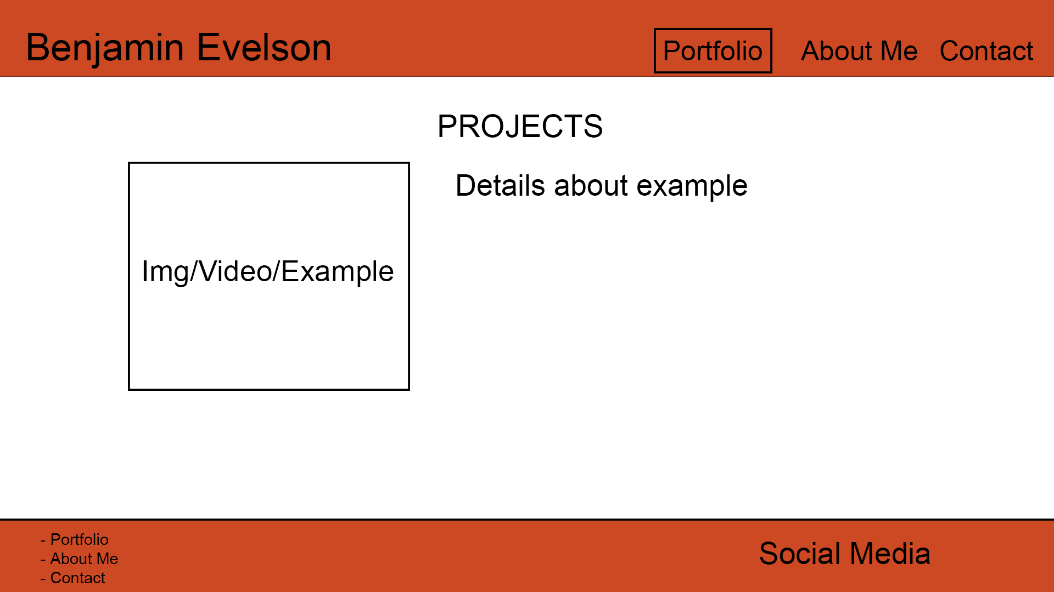
Wireframe

Slide 6
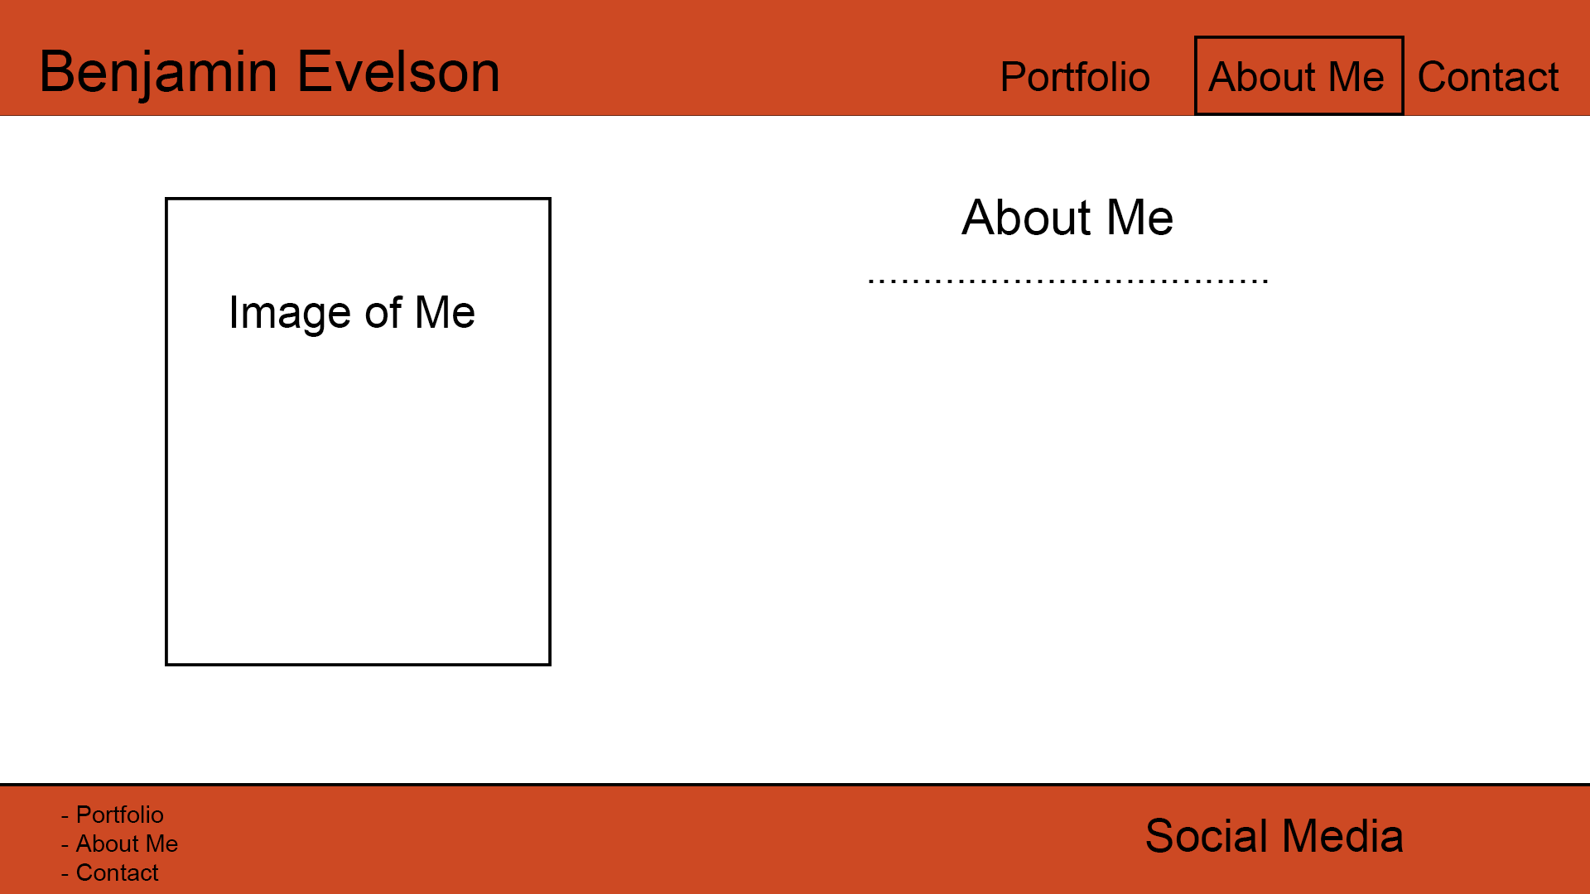
Wireframe

Slide 7
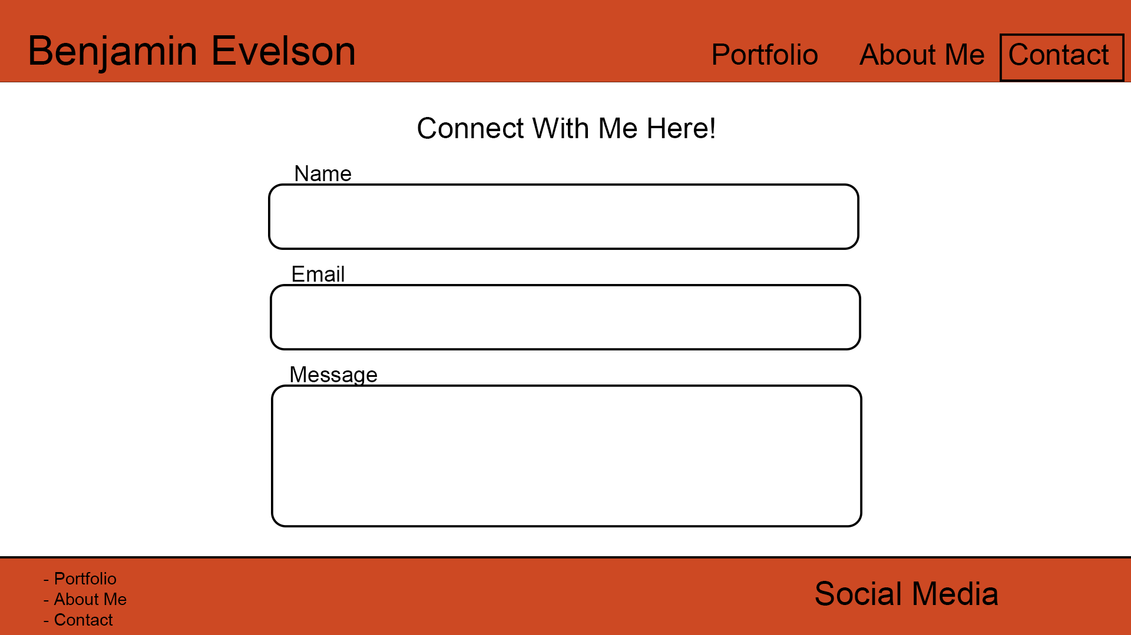
Wireframe

Slide 8
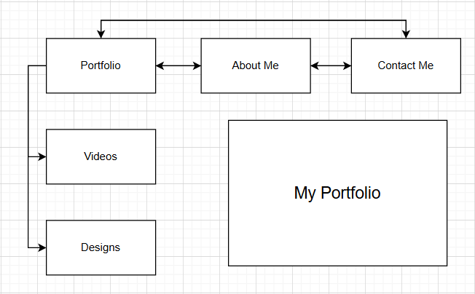
Sitemap

Slide 9
End

